Slide 1
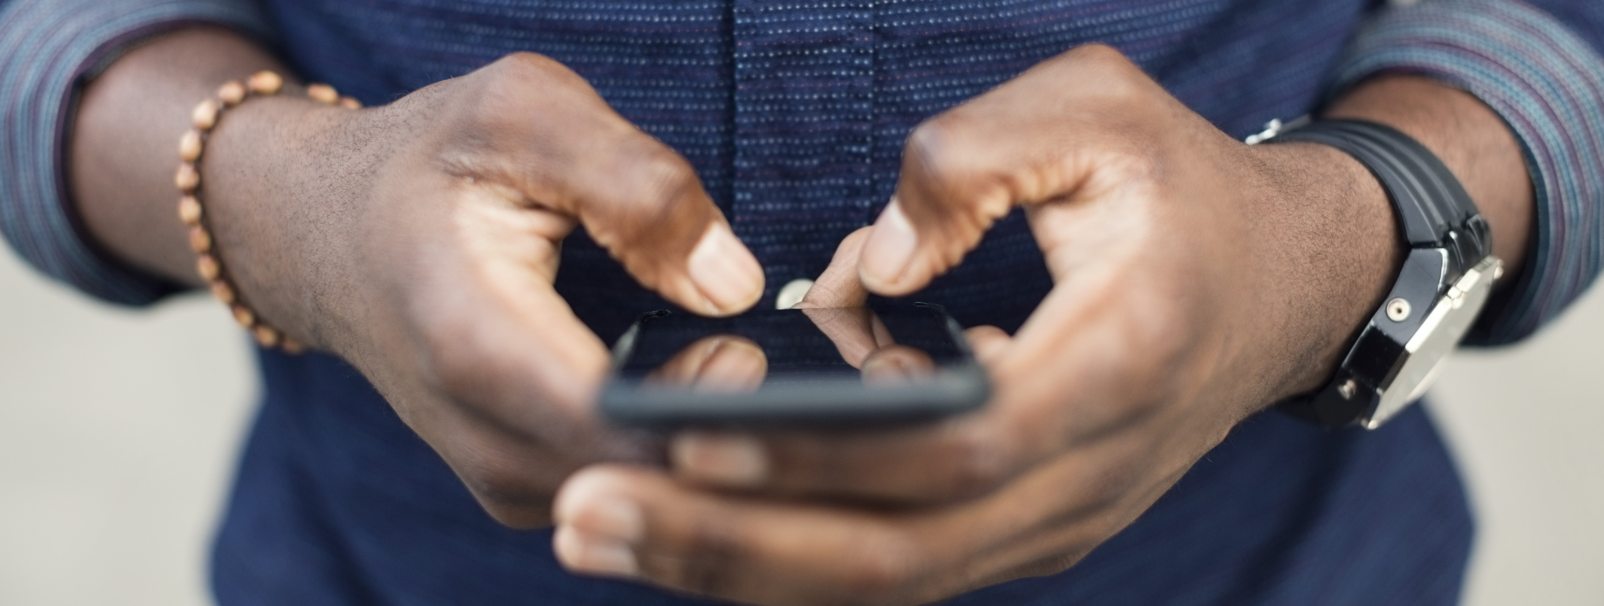
How to refrain from using a smartphone?
Edita

Slide 2
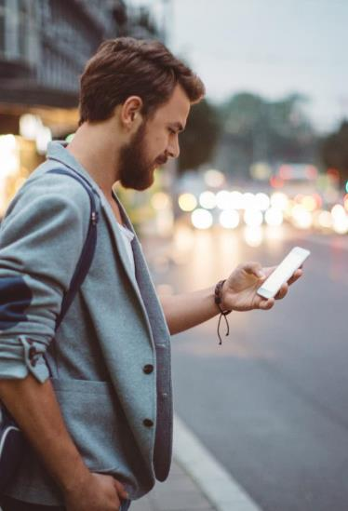
Agenda
Addiction And Smartphones
Why are the people so addicted and how can we make it less so?
What Is The Harm and Why?
How to “fight” it?
Summary And Sources

Slide 3

Addiction is a strong word
Symptoms of an addiction
Loss of control over the behavior
Persistence, or having real difficulty limiting the behavior
Tolerance, the need to engage in the behavior more often to get the same feeling
Severe negative consequences stemming from the behavior
Withdrawal, or feelings of irritability and anxiety when the behavior isn’t practiced
Relapse, or picking up the habit again after periods of avoidance
Addiction is a psychological and physical inability to stop consuming a chemical, drug, activity, or substance, even though it is causing psychological and physical harm.
Notes:
There’s some debate in the medical community as to whether phone overuse is an addiction or impulse control issue.
There are, however, a lot of similarities between phone overuse and other behavioral addictions, like compulsive gambling.

Slide 4
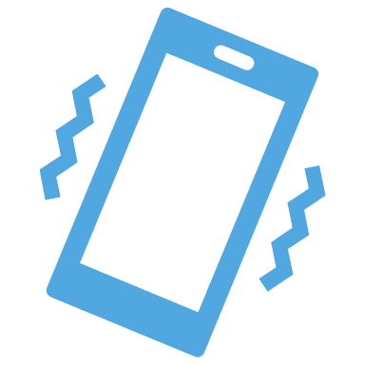
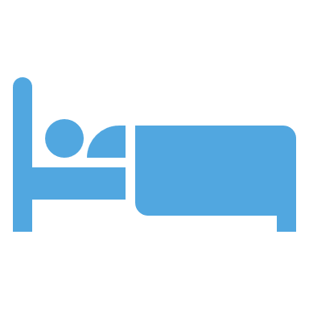





Smartphone Addiction Symptoms
Addiction checklist:
You reach for your phone the moment you’re alone or bored
You wake up multiple times at night to check your phone
You feel anxious, upset, or short-tempered when you can’t get to your phone
There are already defined 3 phobias relating to smartphone use:
Nomophobia: the fear of going without your phone
Textaphrenia: the fear that you can’t send or receive texts
Phantom vibrations: the feeling that your phone is alerting you when it really isn’t
Your phone use has caused you to have an accident or injury
You’re spending more and more time using your phone
Phone use interferes with your job performance, schoolwork, or relationships
People in your life are concerned about your phone use patterns
Notes:
It’s easy to feel like you’re the one who’s lost when you can’t find your phone. So, how do you know whether your attachment to your phone is just a 21st century cultural phenomenon or a genuine, life-altering addiction?
Smartphone addiction is so widely accepted that there’s even3 phobias related to smartphones!

Slide 5


What’s The Harm?
Adolescents are more likely to demonstrate addiction-like symptoms with their cell phone use than other age groups. The overuse of cell phones may cause:
Concentration issues
Anxiety
Depression
Sleep deficits and insomnia
Relationship conflicts
Poor academic or work performance
“Tech Neck” Pain
Notes:
Teenagers tend to overuse their phones more than other age groups. Studies show the earlier a teen starts using a phone, the higher the risk of problematic use patterns.
In the teenage years, the persons identity is being formed and social media uses techniques to keep them interacting and engaging.
Depression Rates and Suicide Risk: The risk of depression appears to go up with smartphone use. The occurrence of depression and suicide is at an all-time high, and some healthcare professionals are pointing to smartphones as the cause of this surge in mental health concerns. These issues are particularly alarming among teenagers.
Poor Attention Spans: Smartphones have a constant, never-ending flow of information that has taken a toll on attention spans. As a result, the prevalence of ADD-like symptoms is on the rise.
Productivity Interference: Smartphone usage impacts productivity in the workplace and also affects a student’s study time. It’s impossible to put a number on the lost work hours that occur each day due to cell phone usage. But many employers and schools are seeing the problem and implementing bans on smartphones.
Tech Neck Pain: There is a term in the medical industry now: “tech neck.” The position of hunching over a smartphone for 8 – 10 hours a day takes a toll on physical health. Sitting with the head down puts stress and pressure on the back and spine, which is bad for posture and increases the risk of neck and back issues.
Sleep Issues: It might seem harmless to scroll a smartphone in bed, but this activity has an impact on sleep patterns. One of the worst things you can do for your sleep is to expose your brain to blue light right before it’s time to sleep. As a result, sleep quality drops, which can have a domino effect on overall health.
Most of us are aware that our smartphone use is making us depressed, anxious, narcissistic, lonely and insecure. Yet, we still do it. WHY?

Slide 6


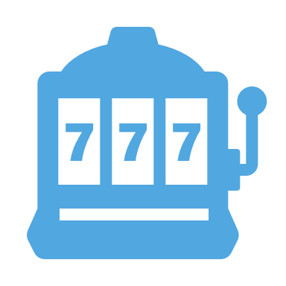


Why is it so addictive?
Main Points
The triggering of chemicals in the brain
The need to socialize, watch others, copy their behavior as well as be seen by others
The “Slot Machine” Effect
The smartphone apps are specifically designed to hold as much of our attention as possible. The longer we spend inside the apps, the more money companies make-off of stealing our attention.
Quickly accessible knowledge
Feeling that it is a part of an “extended self”
Notes:
For many people, social interaction stimulates the release of dopamine and oxytocin. These chemicals also create a sense of belonging and attachment.
Humans are very SOCIAL we need to connect and watch and learn from each other. It is our second nature to copy, imitate and explore the difference as we try to become a better or different self. Phones help us do that.
Every time you make that gentle swiping motion with your thumb to refresh your feed, you are pulling the lever of the slot machine hoping that the next image, the next post, the next email will give you that oh-so-pleasurable dopamine hit
Through searching, we become knowledgeable (even if we lack wisdom).
Becomes a part of an extended self and it is very stressing to lose that.

Slide 7


How to fight the addiction?
Find out if there are underlying worries
Remove time-consuming apps
Eliminate push notifications and alerts
Place some barriers around your phone use
Keep your phone out of sight
Develop hobbies that feed your soul
Adopt a growth mindset
Find an Accountability Partner
Notes:
Knowing what’s truly bothering you could help reduce your need to compulsively text, buy, pin, tweet, swipe, or post.
People who compulsively use cell phones may be trying to avoid issues in their lives that feel too difficult or complicated to resolve.
Other practical tips are:
Remove time-consuming apps from your phone and access them through a device you don’t carry with you all day.
Change your settings to eliminate push notifications and other disruptive alerts.
Place some barriers around your phone use that force you to think about what you’re doing. For example, you could create lock screen questions, like “Why now?” and “What for?”
Keep your phone out of sight. Charge your phone somewhere besides your bedroom. Keep it in the other room during meals. Use a grayscale setting to make it less appealing.
Replace the games and social media apps with hands-on, real-world activities, like meeting up with friends, creating music or art, or doing volunteer work.
Watch out for “dark patterns” : that involve a smartphone app requesting location information that isn’t necessary, or functions such as auto-play, which promote behaviors such as Netflix or YouTube binges watching.
Adopt a growth mindset. Brief relapses, adjustments, and withdrawal symptoms are part of a journey toward healthier phone use. Don’t expect to get it right immediately. Expect some setbacks and learn from each experience.
Find an Accountability Partner: Talk to a friend about your goals and ask them to hold you accountable. If needed, set up a reward/consequence system, so you are motivated to stick to your plan.

Slide 8
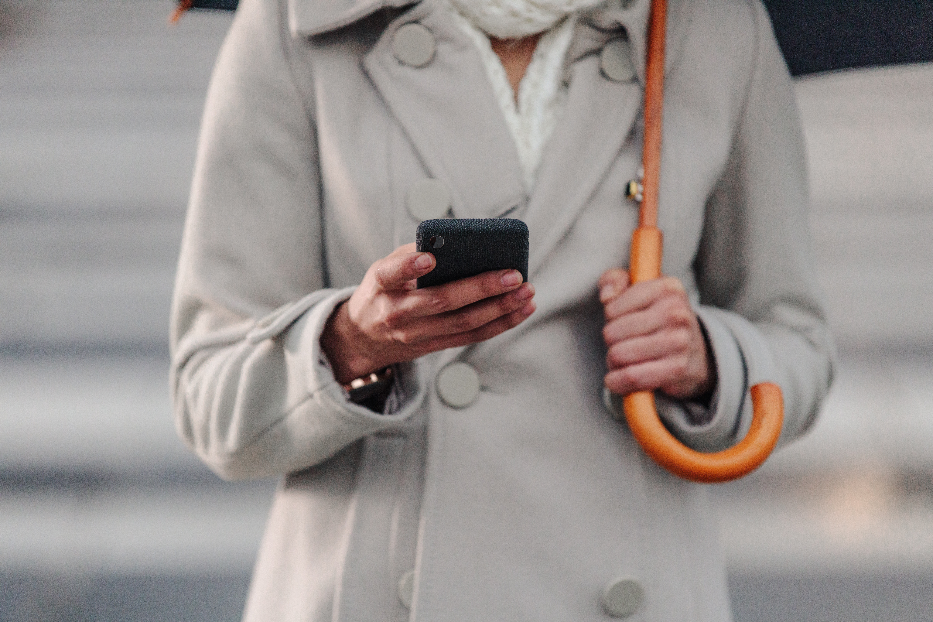
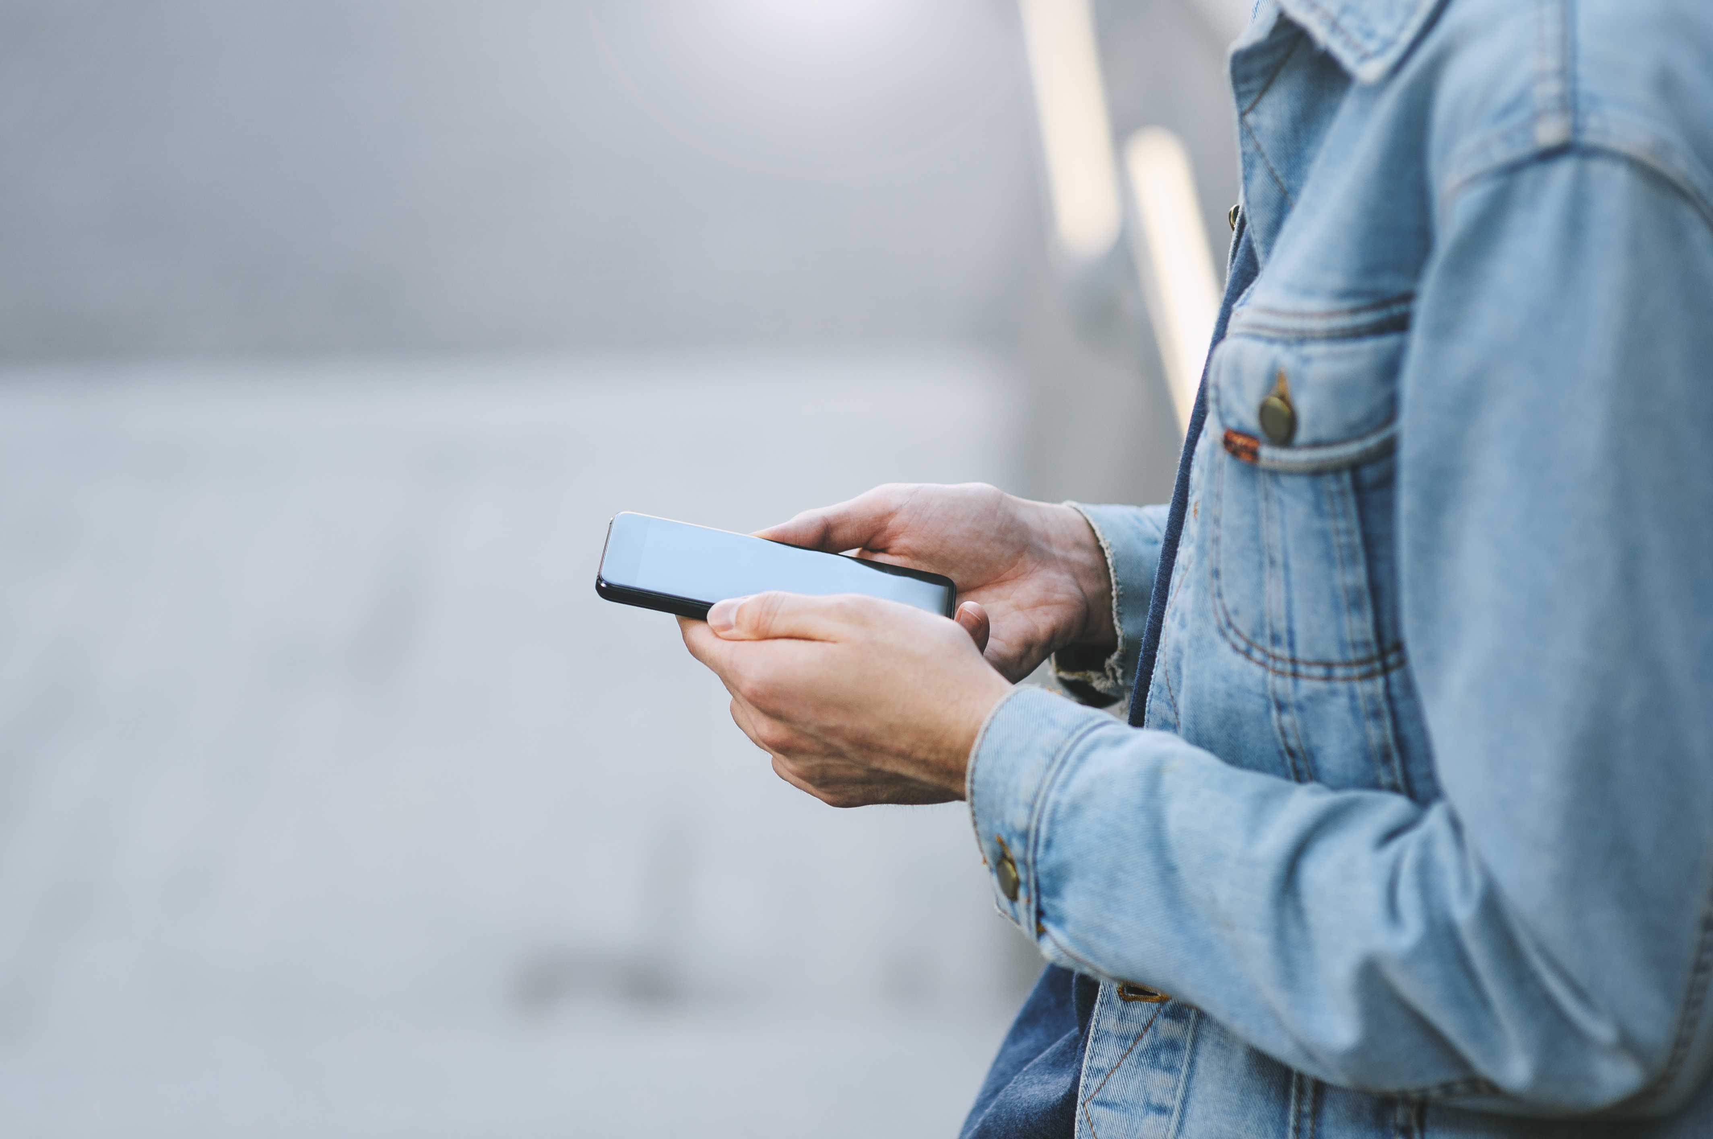
Summary
When used as a collection of tools to improve work, health, parenting, and life, cell phones are wonderful and bring countless benefits. But when used mindlessly and unintentionally, they become a distraction from the things in life that matter most.
Problematic cell phone use shares a lot of characteristics with behavioral addictions.
Adolescents are more likely to demonstrate addiction-like symptoms.
Changing how you operate your smartphone is a long, demanding process.
It is important to become more mindful while using your smartphone.

Slide 9

Sources
https://learnenglishteens.britishcouncil.org/magazine/science-technology/are-we-addicted-our-smartphones
https://www.healthline.com/health/mental-health/cell-phone-addiction
https://www.independent.co.uk/news/long_reads/smartphone-addiction-hypernatural-monitoring-technology-nomophobia-social-media-a8253191.html
https://www.theguardian.com/sbs-on-demand--are-you-addicted-to-technology/2021/apr/21/digital-dilemma-are-you-addicted-to-your-smartphone
https://universityurgent.care/blog/were-all-addicted-to-our-phones
https://theconversation.com/3-reasons-why-we-are-addicted-to-smartphones-84041

Slide 10

Sources
https://www.pcmag.com/how-to/how-to-wean-yourself-off-smartphones-and-social-media
https://www.huffpost.com/entry/cut-back-smartphone-usage_l_5dcc8f20e4b0d43931cef22c
https://www.makeuseof.com/tag/cut-smartphone-usage-changes/
https://www.cnbc.com/2018/01/03/how-to-curb-you-smartphone-addiction-in-2018.html
https://optimizeyourself.me/smartphone-addiction-hacks/
https://betterhumans.pub/the-technology-addicts-guide-to-reducing-phone-usage-9ed728500532
https://www.becomingminimalist.com/break-your-cell-phone-habit/

